Slide 1
HMH Science Dimensions
Unit 8: Evidence for Evolution
Lesson 2: Theory of Natural Selection
Notes:
The learning experiences in this unit prepare students for the mastery of
Performance Expectations
LS1-2 Develop and use a model to illustrate the hierarchical organization of interacting systems that provide specific functions within multicellular organisms.
LS1-3 Plan and conduct an investigation to provide evidence that feedback mechanisms maintain homeostasis.
ETS1-2 Design a solution to a complex real-world problem by breaking it down into smaller, more manageable problems that can be solved through engineering.
ETS1-3 Evaluate a solution to a complex real-world problem based on prioritized criteria and trade-offs that account for a range of constraints, including cost, safety, reliability, and aesthetics, as well as possible social, cultural, and environmental impacts.

Slide 2

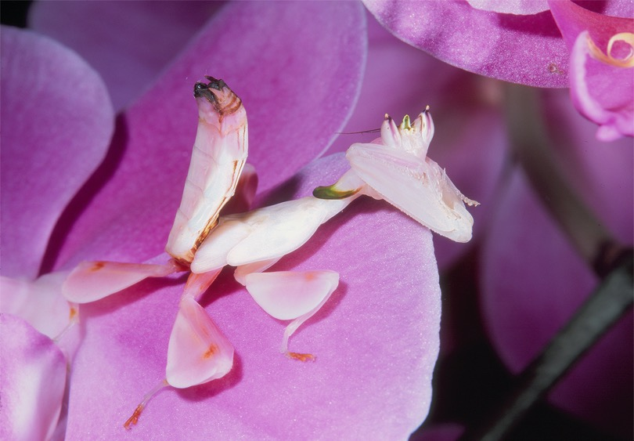
Can You Explain It?
Unit 8 Lesson 2
How do you think the orchid mantis developed the traits that make it so attractive to insects?
The orchid mantis (Hymenopus coronatus) resembles a flower in shape, but some scientists think it attracts insects for another reason.
Notes:
Build on Prior Lessons
In Lesson 1, students learned about different lines of evidence for evolution. Lesson 2 builds on these concepts as students explore natural selection, a mechanism of evolution.
Lesson Objective
Construct an explanation based on evidence for how natural selection leads to changes in populations.

Slide 3
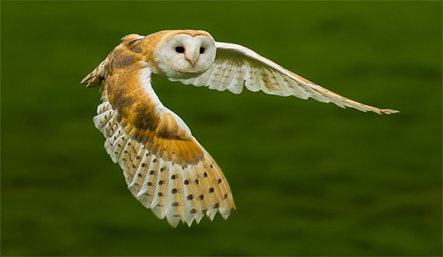
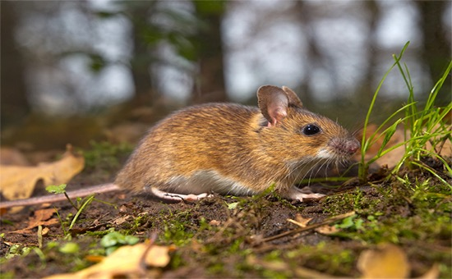

Modeling Natural Selection: Owls and Field Mice Hands-On Lab: Modeling Natural Selection: Owls and Field Mice
Unit 8 Lesson 2
Barn owls are predators.
Barn owls feed mostly on small mammals, such as mice, voles, and shrews.
In this lab, you will model one mechanism of evolution called natural selection.

Slide 4
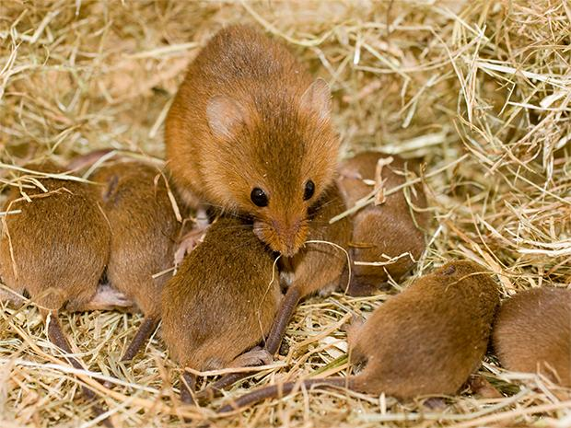
Unit 8 Lesson 2
Modeling Natural Selection: Owls and Field Mice
Mice can reproduce rapidly.
Any traits that help them survive and pass on their genes are considered beneficial in this environment.
Natural selection is a mechanism by which individuals that have inherited beneficial adaptations show differential reproductive success.
Mice can reproduce rapidly. The large number of offspring must compete with one another for resources.

Slide 5
Unit 8 Lesson 2
Modeling Natural Selection: Owls and Field Mice
EXPLAIN
Answer these questions about the concepts explored in this activity.
Name an animal that uses camouflage to avoid predators. What habitat is it most likely to survive in? What are some other traits that could help an animal survive in the presence of predators?
What kinds of resources might field mice compete for? What types of traits would give a field mouse a competitive advantage over other members of its own species?

Slide 6
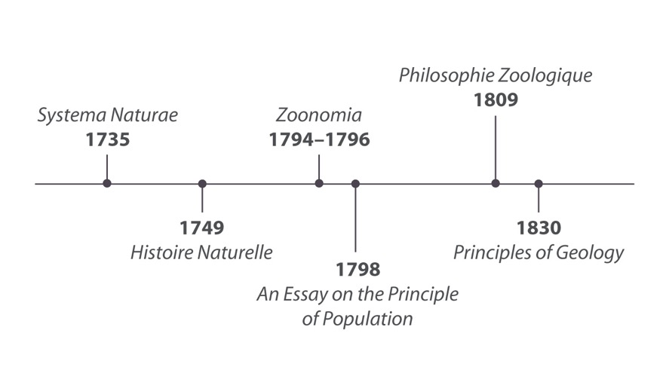
Unit 8 Lesson 2
Developing the Theory of Natural Selection
Charles Darwin was one of the most famous people to consider the question of how living things evolve; however, the concept of evolution had been discussed for more than 100 years when Darwin proposed his theory of evolution.

Slide 7
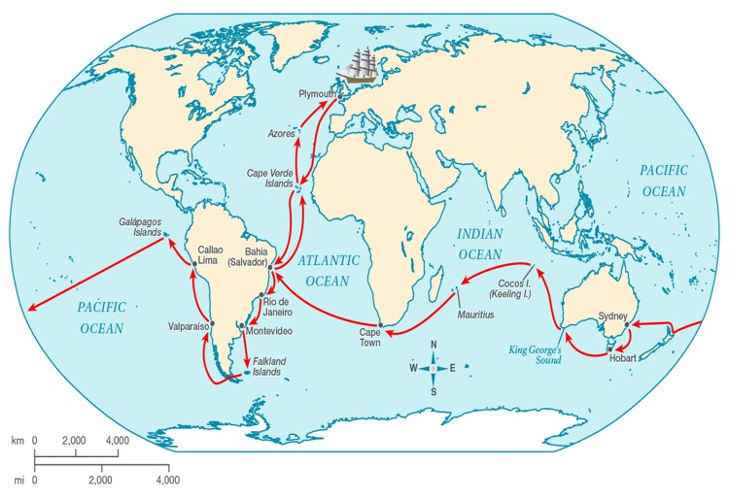
Unit 8 Lesson 2
Developing the Theory of Natural Selection
Darwin’s Voyage
In 1831, the HMS Beagle set sail from England on a five-year journey to map the coast of South America and the Pacific Islands.
The ship captain saw it as an opportunity to collect specimens and study natural history.
GATHER EVIDENCE
As you explore the map of Darwin's journey, gather evidence related to how species change over time. In addition, think about questions Darwin might have asked as he made his observations.

Slide 8
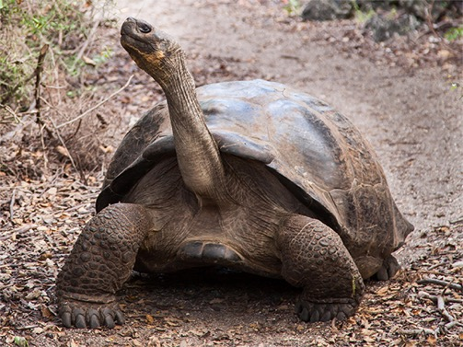
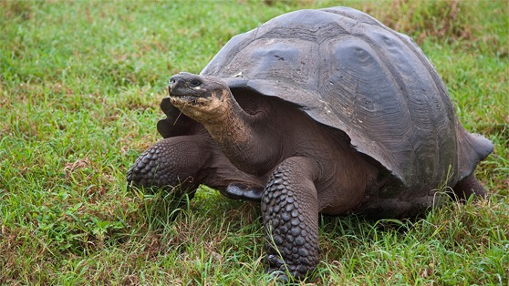
Unit 8 Lesson 2
Developing the Theory of Natural Selection
Darwin made most of his widely known observations (that are still studied today) when the Beagle arrived in the Galápagos Islands.
Darwin noted that the species found on one island looked different from those on nearby islands and on the mainland.
He was struck by the variation of traits among similar species. Some traits seemed well suited to the animals’ environments and diets.
The high shell edge of saddle-backed tortoises allows them to stretch their long necks.
Domed tortoises have a short neck and short legs.

Slide 9
Unit 8 Lesson 2
Developing the Theory of Natural Selection
Among all of Darwin's observations, the most well known are those of the Galápagos finches. These small birds, sometimes known as Darwin's finches, are closely related but have significant differences.
These observations led Darwin to infer that species must somehow be able to adapt to their surroundings.
An adaptation is a feature that allows an organism to survive and reproduce in its environment.
It was this analysis that eventually helped shape Darwin's theory about how organisms change over time.

Slide 10
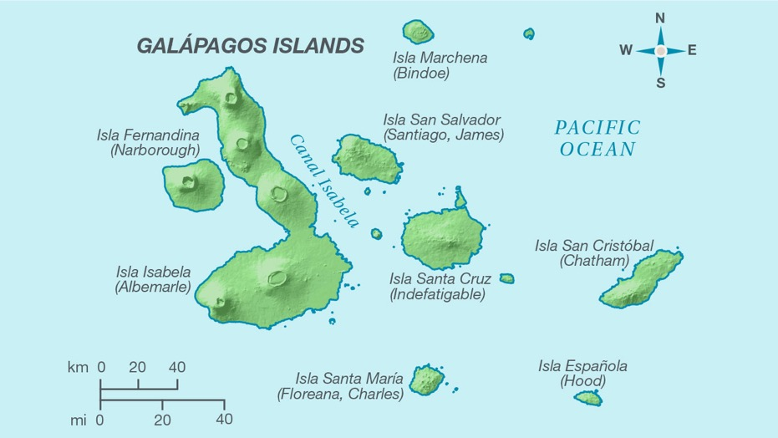
Unit 8 Lesson 2
Developing the Theory of Natural Selection
Use the information from the map to answer these questions:
How do these finches' adaptations help them survive and reproduce in their environment?
What type of beak would you expect to see on a finch that eats insects? Explain your answer.

Slide 11
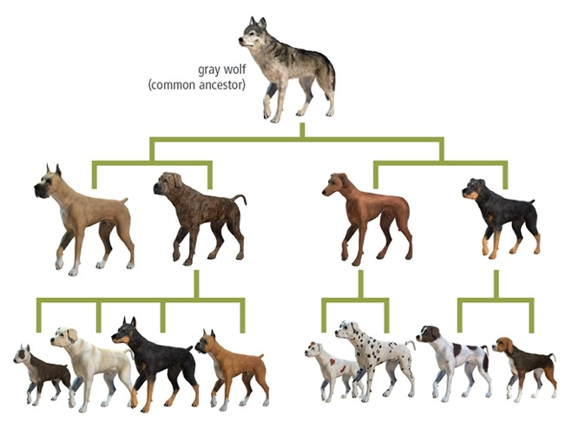
Unit 8 Lesson 2
Developing the Theory of Natural Selection
The process by which humans change a species by breeding it for certain traits is called artificial selection.
In this process, humans make use of the genetic variation in plants and animals by acting as the selective agent. That is, humans determine which traits are favorable and then breed individuals that show those traits.
COLLABORATE
Discuss this question with a partner: How is artificial selection different from genetic engineering?

Slide 12
Unit 8 Lesson 2
Developing the Theory of Natural Selection
Heritability is the ability of a trait to be passed down from one generation to the next.
In artificial selection, individuals with desired traits are bred over generations, but only if the traits are advantageous to breeders. However, breeders also might select against features that are not desirable or "useful.”
During artificial selection, humans act as the selective agent. In nature, however, the environment generates the selective pressure that determines if a trait is passed on or not.

Slide 13
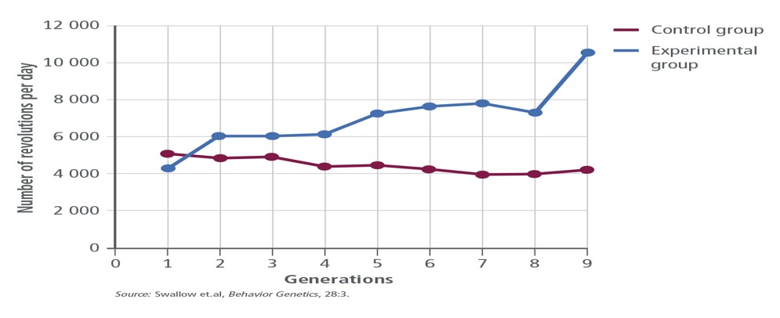
Developing the Theory of Natural Selection Cause and Effect
Unit 8 Lesson 2
ANALYZE
What is the difference in results between the mice in the control group and the mice in the experimental group?
Use the trend in the data to make a prediction about the number of revolutions on the wheel per day for mice in Generation 10 of the experimental group.

Slide 14
Developing the Theory of Natural Selection
Unit 8 Lesson 2
EXPLAIN
Make a graphic organizer to summarize Darwin's findings, and illustrate how each observation relates to the processes that lead to changes in species.

Slide 15
Principles of Natural Selection
Unit 8 Lesson 2
Charles Darwin was not the only person to develop a theory to explain how evolution may take place. An English naturalist named Alfred Russel Wallace independently developed a theory very similar to Darwin’s.
In 1858, the ideas of Darwin and Wallace were presented to an important group of scientists in London.
PREDICT
Why were Darwin and Wallace's ideas presented to other scientists before they were published?

Slide 16
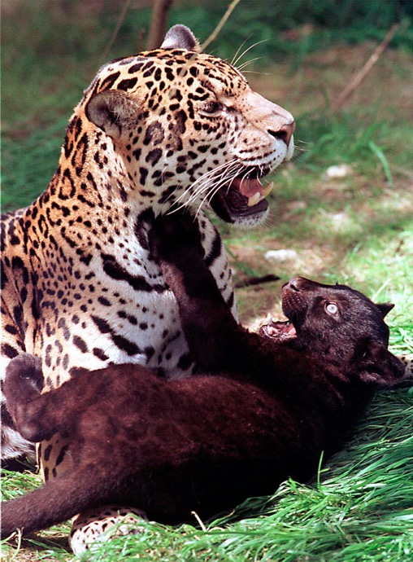
Principles of Natural Selection
Unit 8 Lesson 2
Gregor Mendel's work showed that traits are passed down from parents to offspring and that traits are inherited independently of one another.
Traits are coded for by genes and that alleles are different variations of the same gene.
Variation in the alleles between individual organisms within a population is called genetic variation. Genetic variation is the basis for natural selection.
Variation in coat color can be seen in jaguars and their offspring.

Slide 17
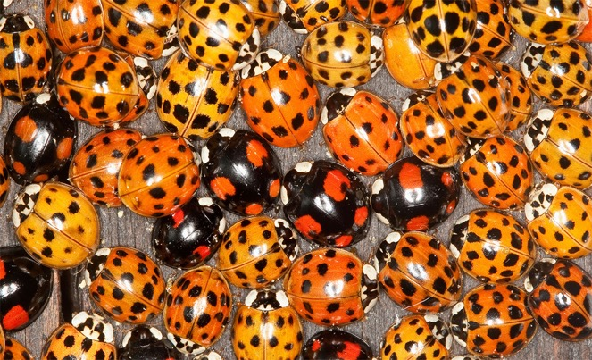
Principles of Natural Selection
Unit 8 Lesson 2
Genetic variation is increased by sexual reproduction.
In sexual reproduction, the offspring receives two forms of each gene, one from each parent.
Genes are segregated during the formation of gametes.
If the genes are not linked, they will segregate separately, or undergo independent assortment.
Sexual reproduction increases genetic variation.

Slide 18
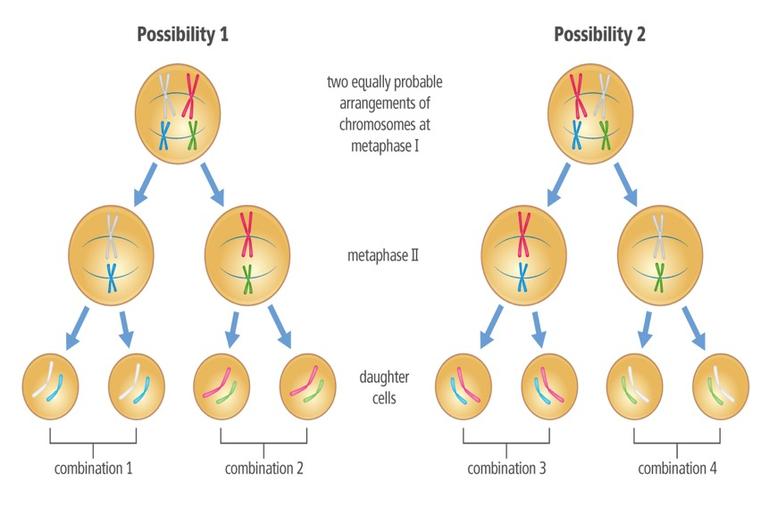
Principles of Natural Selection
Unit 8 Lesson 2
Genetic variation is increased by meiosis.
As genes are lined up and shuffled in different ways during meiosis, various combinations of genetic material are generated.
As a result, sexually reproducing organisms exhibit variety in their traits.
Independent Assortment | Chromosomes separate independently during meiosis. As a result, gametes have many different combinations of genes.

Slide 19
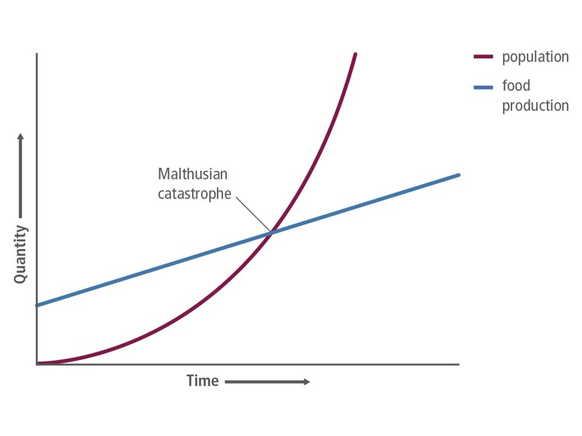
Principles of Natural Selection
Unit 8 Lesson 2
Overproduction
Thomas Malthus pointed out the potential of human populations to grow exponentially if there was a constant birth rate and ideal conditions; unlimited resources and an absence of predators or disease.
However, human populations are limited by many factors, such as disease, war, and limited resources.
Malthus predicted that population growth would outpace food production, causing a "Malthusian catastrophe."

Slide 20

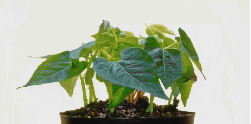
Unit 8 Lesson 2
Principles of Natural Selection
Observe competition among plants in this time-lapse footage.

Slide 21
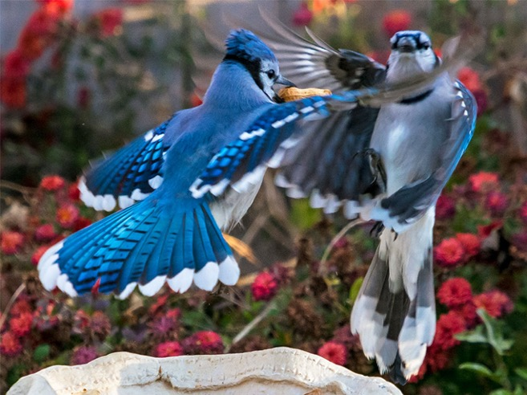
Principles of Natural Selection
Unit 8 Lesson 2
Darwin noted that more offspring are born than can survive. Environments place limits on population growth, where some individuals are more successful at survival than others.
Those individuals that survive better and produce more offspring will have their traits passed on to subsequent generations.
Individuals compete for resources such as food.
What are some traits that might allow a bird to outcompete other birds for food?

Slide 22
Principles of Natural Selection
Unit 8 Lesson 2
Adaptation
Sometimes, a certain variation allows an individual to survive better than other individuals it competes against in its environment.
More successful individuals are "naturally selected" to live longer and to produce more offspring that share those adaptations.
Over time, natural selection will result in species with adaptations that are well suited for survival and reproduction in an environment.

Slide 23
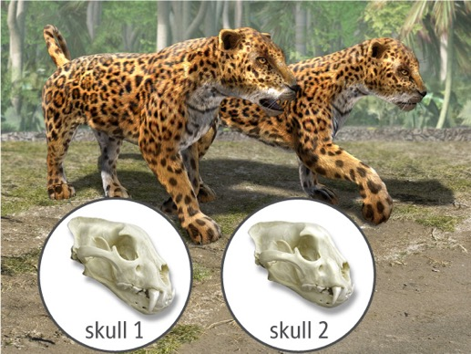
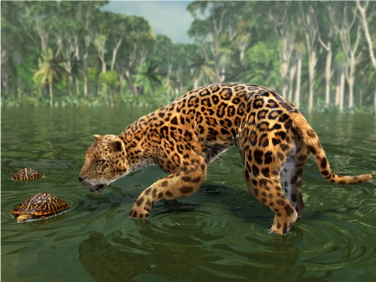
Principles of Natural Selection
Unit 8 Lesson 2
About 11,000 years ago, many species faced extinction. Jaguars
faced a shortage of food due to the changing climate of that time.
EXPLAIN
Why did larger jaws and teeth become more common in the jaguar species over time? How do the four principles of natural selection explain these changes?

Slide 24
Principles of Natural Selection
Unit 8 Lesson 2
In biology, the term fitness is a measure of the ability of an organism to survive and produce more offspring relative to other members of the population in a given environment.
An individual with high fitness is well adapted to its environment.

Slide 25
Principles of Natural Selection Cause and Effect
Unit 8 Lesson 2
Natural selection causes populations to adapt over time. The main principles of natural selection are:
Genetic Variation There is natural variation in the population.
Overproduction More offspring are produced than can survive.
Competition Individuals must compete for resources, and some will outcompete others.
Adaptation Over time, beneficial traits become more common in the population, as individuals with those traits survive better and reproduce more often.

Slide 26
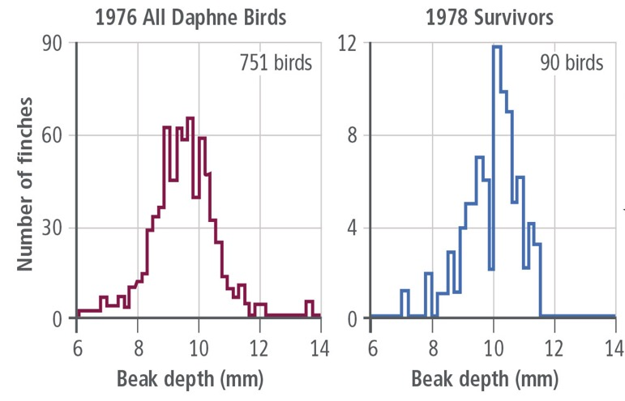
Principles of Natural Selection
Unit 8 Lesson 2
Ecologists observed an example of natural selection acting on existing traits within a population of medium ground finches on one of the Galápagos Islands.
A drought in 1977 reduced the number of the small, soft seeds that the finches preferred. However, there were still plenty of large, tough-shelled seeds.
What can you infer about how the finch population changed after the 1977 drought?

Slide 27
Principles of Natural Selection
Unit 8 Lesson 2
Misconceptions About Natural Selection
Natural selection does not produce individuals who are perfectly suited to their environment.
Natural selection does not produce ideal traits because it acts only on traits that already exist.
Many mutations have harmful results and therefore are not likely to produce a trait that is beneficial in a given environment.
Natural selection leads to changes in populations, not in individual organisms.

Slide 28
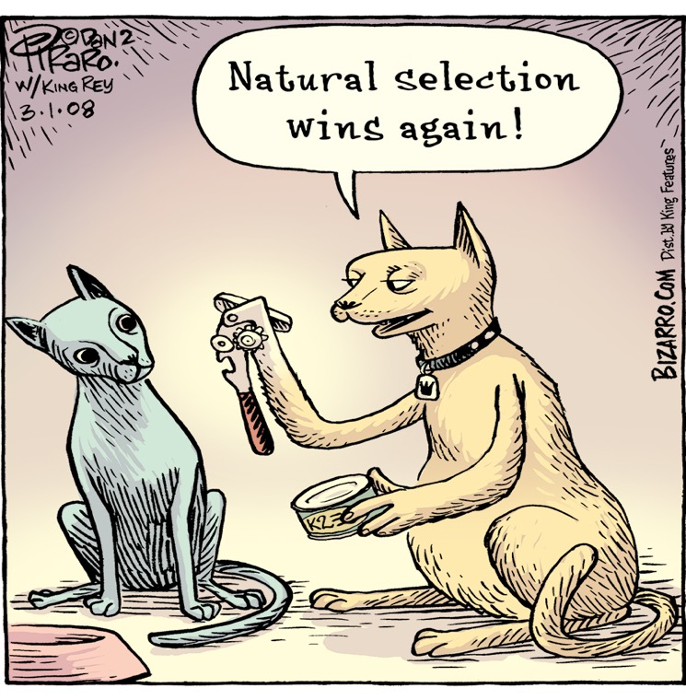
Principles of Natural Selection
Unit 8 Lesson 2
How does the cartoon of the cats demonstrate a misunderstanding of the theory of natural selection?
This cartoon depicts a misconception about natural selection. The cat on the right has developed a can opener for a hand.

Slide 29
Unit 8 Lesson 2
Principles of Natural Selection
MODEL
Think back to the owls and field mice simulation.
Were the four main principles of natural selection modeled accurately?
How could you improve this model to reflect the principles of natural selection more effectively?

Slide 30
Unit 8 Lesson 2
Continue Your Exploration
Choose one of the paths below to continue your exploration:
Modeling Natural Selection
Genetic Diversity in Florida Panthers
Natural Selection Today
Biomechanics of Stag Beetle Jaws

Slide 31
Can You Explain It?
Unit 8 Lesson 2
Refer to the notes in your Evidence Notebook and use what you have learned about natural selection to make a claim for how this trait could have evolved over time. Include a discussion of each of the principles of natural selection and how they led to the adaptations we see in modern-day orchid mantises.
State your claim.
Use evidence to support your claim.
Explain how the evidence you cited supports the claim you are making.

Slide 32
Image Credits
Unit 8 Lesson 2
mantis ©Chris Parks/Image Quest Marine/Alamy; barn owl ©selectimages/Fotolia; mouse ©CreativeNature_nl/iStock/Getty Images Plus; mother and mice ©Steve Downer/ardea/Mary Evans Picture Library Ltd/age fotostock; saddleback tortoise ©Gail Tanski/Alamy; domed tortoise ©John Warburton-Lee Photography/Alamy; jaguar mother and cub ©AP Images; Bizarro cartoon ©2008 Dan Piraro Distributed by King Features Syndicate, Inc.; multicolored Asian beetles ©blickwinkel/Hecker/Alamy

